Slide 1
Java Collection framework

Slide 2
Collections in Java
A Collection is a group of individual objects represented as a single unit. Java provides Collection Framework which defines several classes and interfaces to represent a group of objects as a single unit.
The Collection interface (java.util.Collection) and Map interface (java.util.Map) are the two main “root” interfaces of Java collection classes.
Need for Collection Framework : Before Collection Framework (or before JDK 1.2) was introduced, the standard methods for grouping Java objects (or collections) were Arrays or Vectors or Hashtables. All of these collections had no common interface.
Accessing elements of these Data Structures was a hassle as each had a different method (and syntax) for accessing its members:

Slide 3
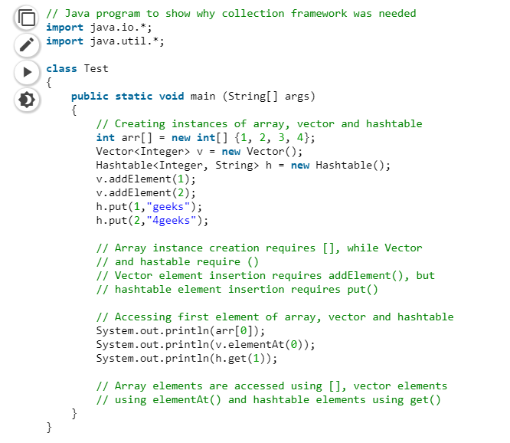

Slide 4
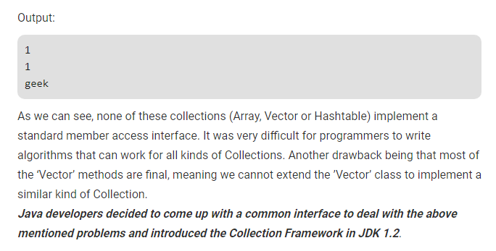
Both legacy Vectors and Hash tables were modified to conform to the Collection Framework.
Advantages of Collection Framework:
Consistent API : The API has a basic set of interfaces like Collection, Set, List, or Map. All classes (Array List, Linked List, Vector, etc) that implement these interfaces have some common set of methods.
Reduces programming effort: A programmer doesn’t have to worry about the design of Collection, and he can focus on its best use in his program.
Increases program speed and quality: Increases performance by providing high-performance implementations of useful data structures and algorithms.

Slide 5
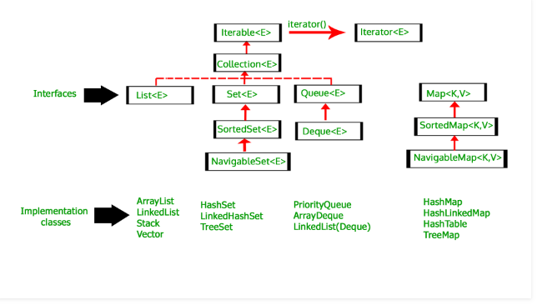

Slide 6
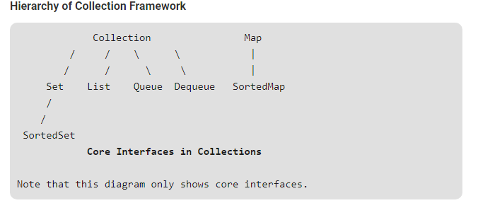

Slide 7
Learning on sorting of collections
a. to sort lists (both linkedlist() & arraylist() ) : u have collection.sort(List list)
b. to sort set : we have treeset (no sortedSort becasue its an Interface not implementation classes & no
collection.sort because it only accepts list.)
c. to sort map : we have treemap (no sortedMap becasue its an Interface not implementation classes & no
collection.sort because it only accepts list.)

Slide 8
